Slide 1

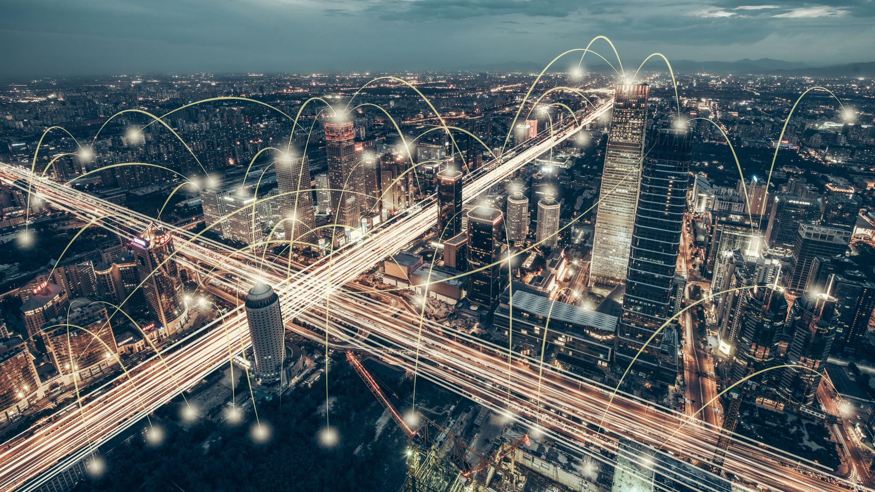
Group 6-TBD
Karim Hammoud
Dongjie Li
Adityo Mukti
Yanting Yang

Slide 2
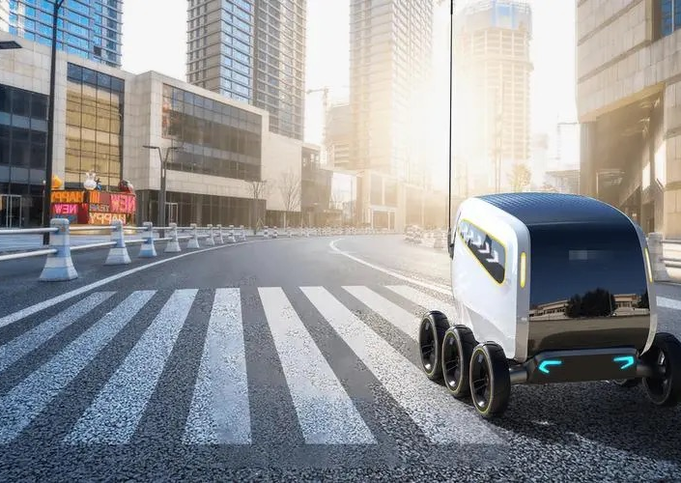
Automated Delivery
Scenarios
1.Food and goods delivery
2.Healthcare
3.Urban logistics
4.Postal Services
Improve efficiency
Reduce cost
Reduce exposure

Slide 3
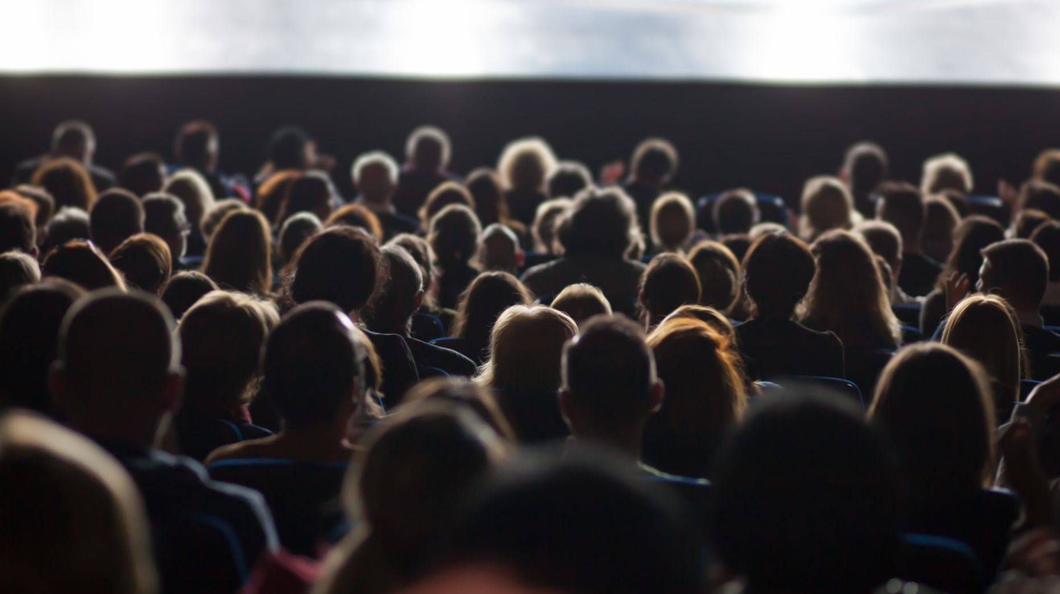
Live crowd monitoring
Use of drones
On site cameras
Filter live footage to enable:
Management
Security
Efficient Transport
Efficient Energy Distribution

Slide 4
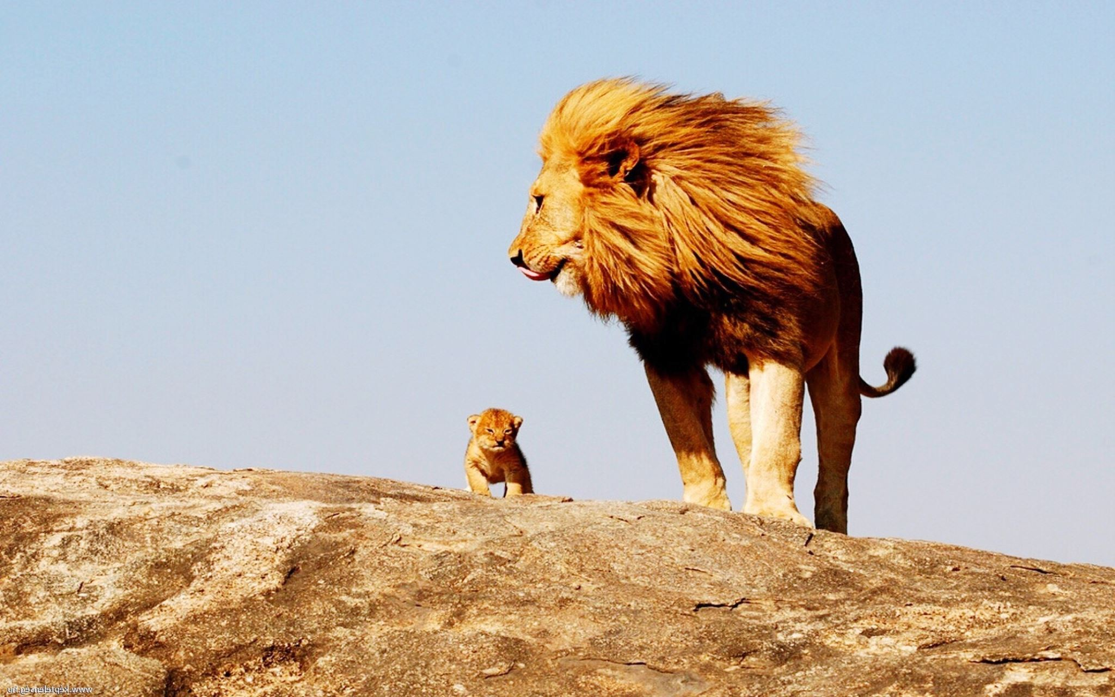
Anti-Poaching System
Combination of IoT cameras and drones. Real-time data collection and analysis.
IoT-enabled cameras for surveillance. - Automatic trespassers, poachers detection
Drones for aerial monitoring. - Poaching activity detection, detect animals that need AID
Data analytics for threat detection - Natural threats: Wildfire - Human threats:

Slide 5
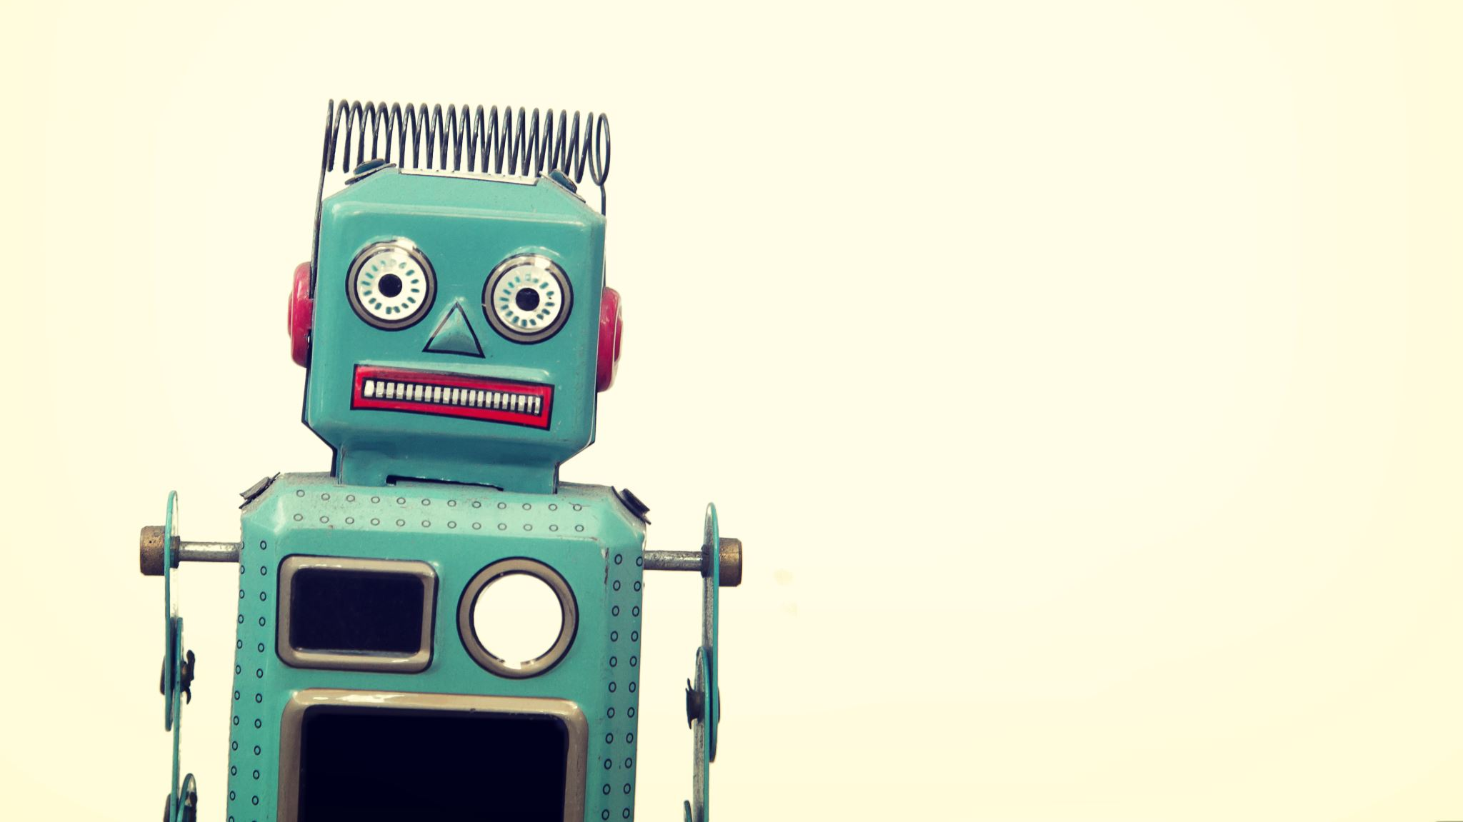
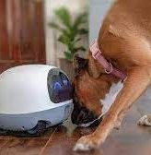
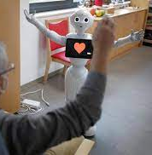
Companion Robot
For Elderly
Detect physical data like heart rate/body temp(IR)
Detect Facial expression/body language to show any symptoms or mental issues
Able to communicate with so that they have someone to talk to.
Upload the to the Cloud and linked with their children or GPs
For Pets
Accompany your pets outside
Locate
Give instructions/Feed

